Slide 1
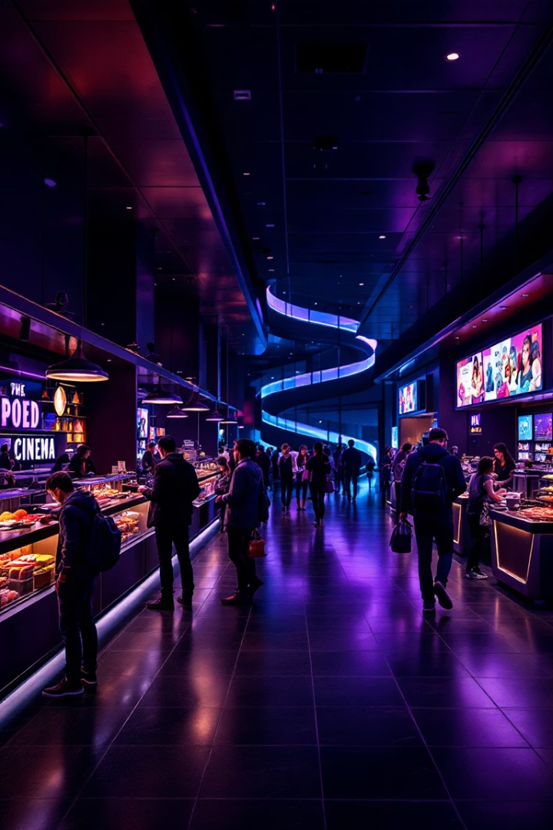
Enhancing F&B Strategy at Village Cinemas Using Data Science
Presented by Team 1 RMIT
Welcome to our project presentation for Village Roadshow's Food and Beverage operations. As RMIT University Data Science Postgraduate students, we've partnered with Village Roadshow Group to transform their cinema refreshment experience through data-driven insights. Our project optimizes F&B operations by addressing inventory, demand forecasting, revenue prediction, and combo offers to create a more profitable and customer-friendly experience.

Slide 2






Business Problem
Unpredictable Demand
High variability based on genre, day, and session time
Inefficient Inventory Management
Understocking or overstocking issues
Revenue Loss & Experience Impact
Reduced satisfaction and missed sales opportunities
Village Cinemas faces significant challenges in managing their F&B operations due to the unpredictable nature of customer demand. Various factors including movie genre, day of the week, and session timing create complex patterns that traditional inventory planning struggles to address.
When inventory doesn't match demand, the business suffers from either stockouts (disappointing customers and losing sales) or excess inventory (leading to waste and increased costs). These inefficiencies directly impact both the bottom line and customer satisfaction.

Slide 3
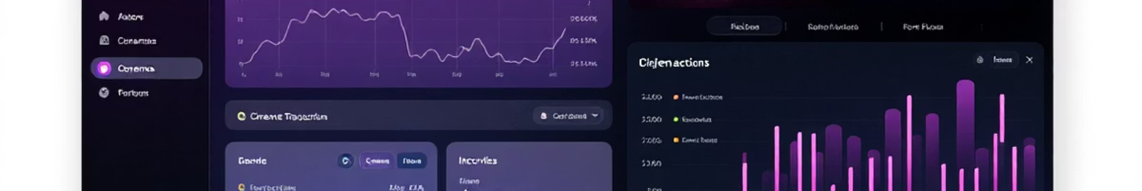
Data Acquisition
Inventory Transactions (2023-2024)
Movie Session Metadata
Combo Master Data
Item class categorization
Session hour and duration
Predefined combo offerings
Quantity and pricing details
Genre and language information
Bundle component details
Transaction timestamps
Movie ratings and attendance
Pricing structure information
Village Cinemas provided us with comprehensive datasets from Sunshine location covering all aspects of their F&B operations. This rich data source included detailed inventory transactions spanning 2023-2024, comprehensive movie session information, and complete combo offering details.
Our team processed these datasets through rigorous cleaning, transformation, and feature engineering to prepare them for advanced modeling. The resulting integrated dataset allowed us to explore the complex relationships between movie attributes and F&B purchasing behaviors.

Slide 4
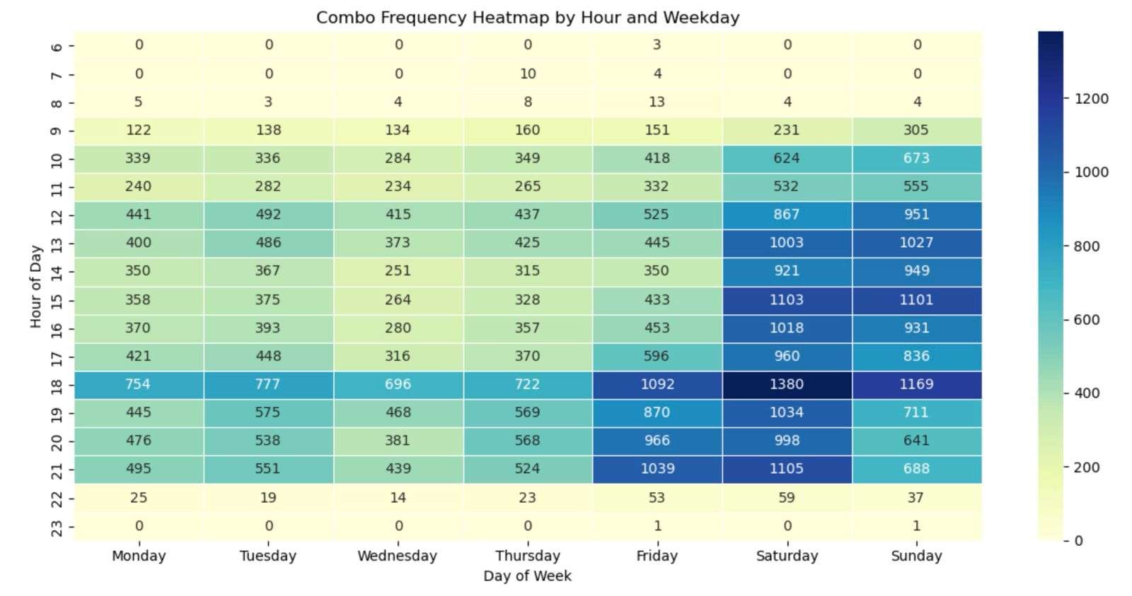
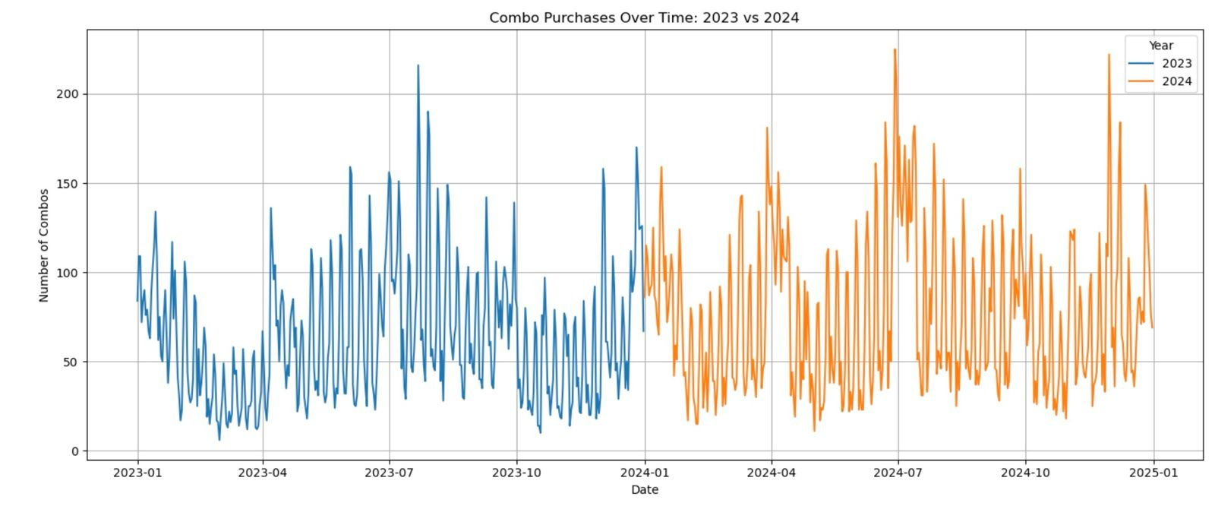
Exploratory Data Analysis & Key Insights
Genre Impact on Sales
Sales by Session Time
Combo Frequency Heatmap Analysis
2023 vs 2024 Performance Comparison
s.

Slide 5
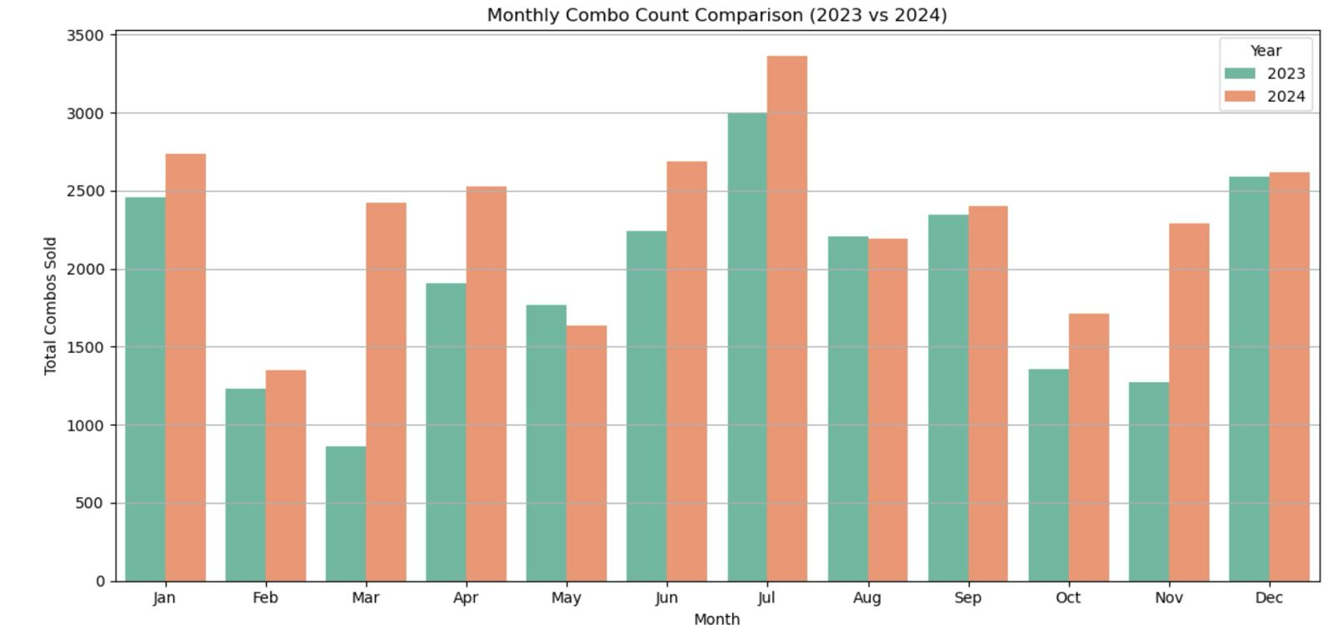
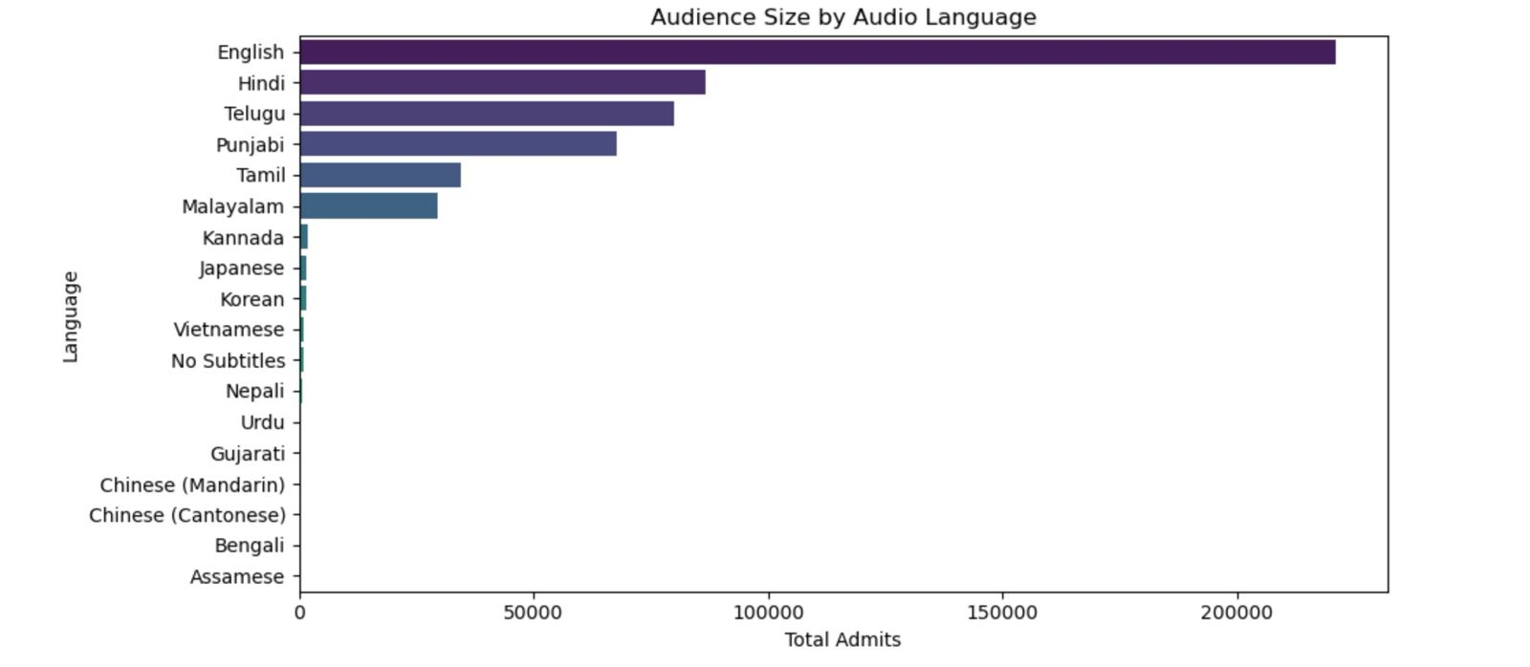
Cinema Combo Sales Analysis
Monthly combo count comparison (2023 vs 2024)
Demographic Diversity & Language Audience

Slide 6
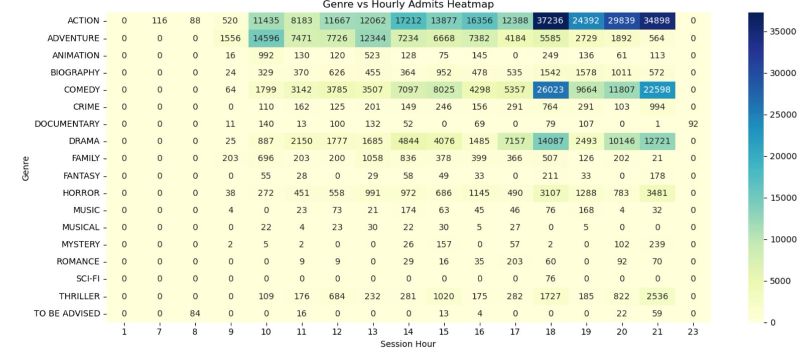
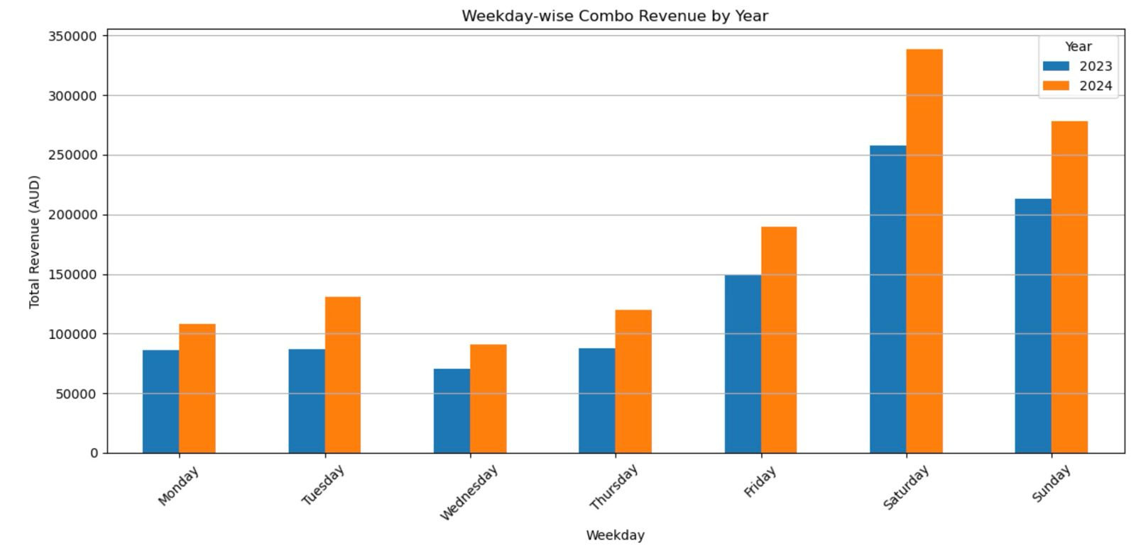
Cinema Combo Sales Analysis
Genre Performance
Weekly Revenue Performance Analysis

Slide 7




Proposed Solutions
Revenue Forecasting
Advanced regression models predicting hourly and session-wise revenue
Item Class Sales Prediction
Multi-output regression forecasting demand for individual F&B categories
Combo Deal Optimization
Market Basket Analysis identifying profitable item pairings
Our comprehensive approach addresses Village Cinemas' F&B challenges through three interconnected data science solutions. Each solution tackles a specific aspect of the business problem while contributing to the overall optimization strategy.
We implemented sophisticated machine learning models including CatBoost, XGBoost, and Random Forest to accurately predict revenue streams and item-specific demand. These predictions enable proactive inventory management and staffing decisions. Additionally, our Market Basket Analysis reveals natural product affinities that can be leveraged for more effective combo offerings.

Slide 8
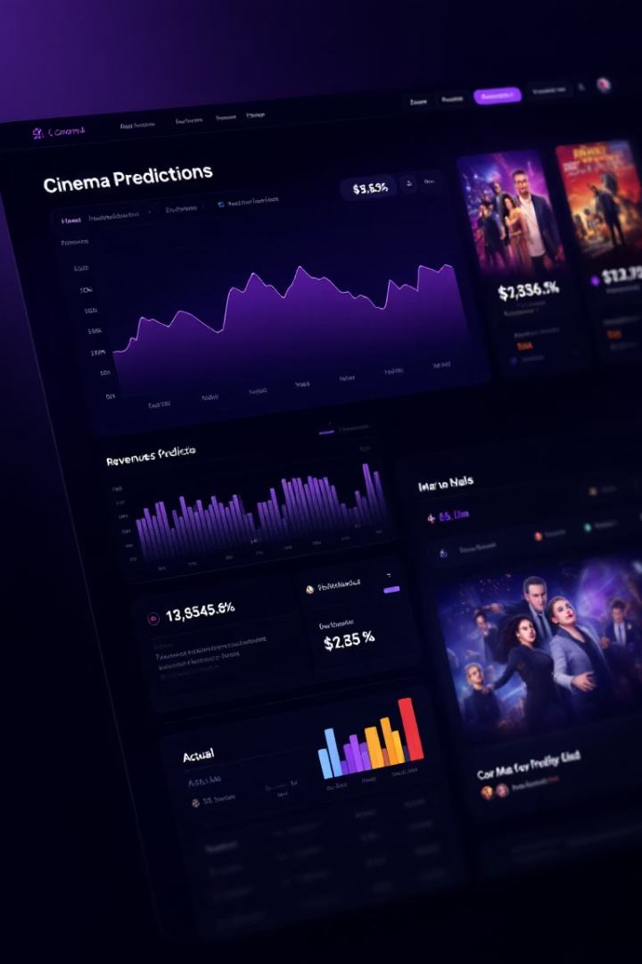
Revenue Forecasting
0.77
R² Score
Strong predictive performance
$82.04
MAE
Average prediction error
$130.43
RMSE
Root mean squared error
10.81%
Accuracy (±10%)
Predictions within 10% margin
After extensive model comparison and hyperparameter tuning, we selected the CatBoost Regressor as our primary revenue forecasting engine. This gradient boosting algorithm consistently outperformed alternatives in predicting session-based F&B revenue with impressive accuracy.
The model achieves an R² score of 0.77, indicating it captures a significant portion of revenue variability. With an average error of just $82.04 per session, Village Cinemas can now make informed decisions about staffing levels, inventory planning, and promotional strategies based on anticipated revenue streams.

Slide 9








Item Class Sales Forecasting
Popcorn
Drinks
Highest prediction accuracy
Size-specific predictions
Core product focus
Strong R² for large sizes
Snacks
Ice Cream
Lower prediction accuracy
Moderate prediction accuracy
Higher variability in selection
Seasonal considerations
Our item class forecasting model takes prediction granularity to the next level by implementing a MultiOutputRegressor with CatBoost. This approach allows us to simultaneously predict demand for multiple F&B categories for each individual cinema session hour.
By leveraging rich session metadata including genre, duration, time, language, and attendance figures, we've created a powerful tool for inventory planning. Village Cinemas can now anticipate specific category demands, ensuring they have the right mix of popcorn, drinks, and snacks, Etc. for each movie session.

Slide 10

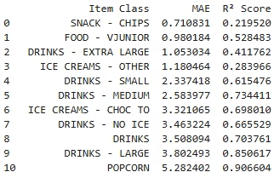
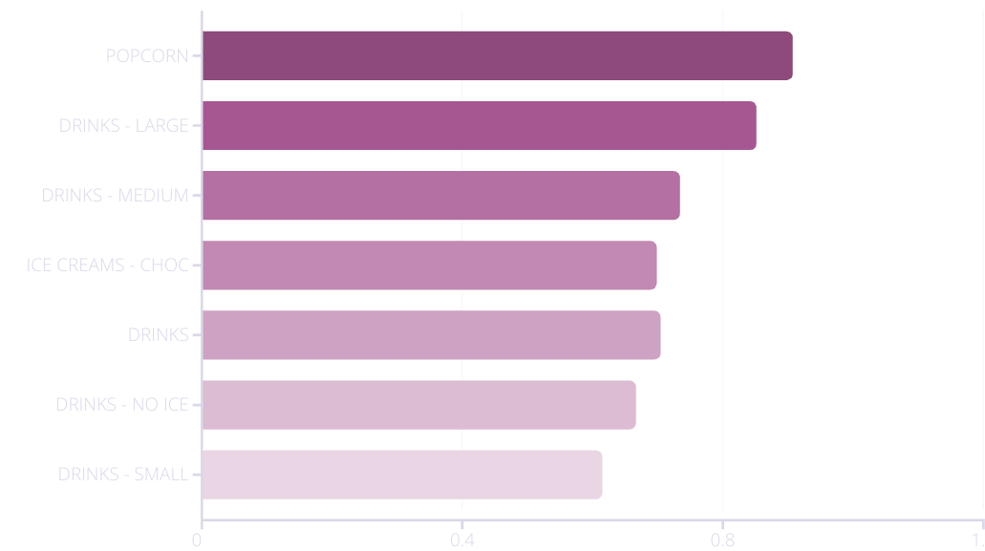
Forecast Results by Item Class
Our MultiOutput Regressor shows impressive prediction performance across various item classes, with particularly strong results for high-volume categories. Popcorn predictions achieved an outstanding R² score of 0.91, while large drinks followed closely at 0.85.
Medium-sized drinks and chocolate ice cream products also showed solid predictive performance with R² scores above 0.69. Even categories with more moderate scores provide valuable insights for inventory planning. These results give Village Cinemas confidence in making data-driven stocking decisions across their product range.

Slide 11



MAE Interpretation & Business Integration
Understanding MAE
Mean Absolute Error quantifies average prediction error in units sold
Critical for gauging over/understock risk per item class
Decision Sensitivity
High-profit items with large understocking costs require buffer margins
Collaborative Adjustment
Lower-margin items can tolerate tighter inventory management
Business teams adjust model thresholds based on MAE insights
Operational expertise combined with model predictions for optimal results
Mean Absolute Error (MAE) provides a practical measurement of prediction uncertainty that directly translates to business risk. For example, a popcorn MAE of 5.28 means actual sales typically differ from predictions by about 5 units per session, allowing inventory planners to add appropriate safety margins.
We recommend Village Cinemas use a collaborative approach where operational teams apply their expertise to interpret model errors. High-value items with significant understocking costs might warrant larger buffers, while lower-margin items can be managed more tightly, balancing service goals with cost considerations.

Slide 12
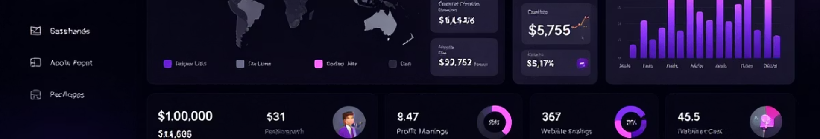



Interactive Dashboard Preview
Revenue Forecasts
Item Class Predictions
Combo Recommendations
Interactive visualizations showing predicted revenue by session, day, and movie type
Detailed forecast breakdowns for each F&B category with confidence intervals
Market basket insights showing natural product pairings for optimized combos
Our interactive dashboard integrates all forecasting outputs into a single, intuitive interface, translating complex predictive models into actionable business insights. Village Cinemas staff can easily filter by location, session time, movie genre, and item class to access tailored forecasts, empowering them to make informed decisions.
This unified data view serves as both an operational tool for day-to-day decision-making and a strategic platform for longer-term planning. This dashboard also serves as a direct gateway to the live demonstration, where we will showcase its full capabilities, including market basket analysis for optimizing combo deals and promotions.

